Slide 1
Computational Complexity
Ref: CLRS 3rd edition (Chapter 34 initial portion) and
Algorithm Design (Kleinberg+Tardos)
Adapted from the slide prepared by Dr. Md. Shamsuzzoha Bayzid

Slide 2
Introduction
Polynomial-time algorithms => on inputs of size n, the worst-case running time is O(n^{k}) for some constant k.
There are problems, such as Turing’s famous “Halting Problem,” that cannot be solved by any computer, no matter how much time we allow.
There are also problems that can be solved, but not in time O(n^{k}) for any constant k.
Generally, we think of problems that are solvable by polynomial-time algorithms as being tractable, or easy, and problems that require super-polynomial time as being intractable, or hard.

Slide 3
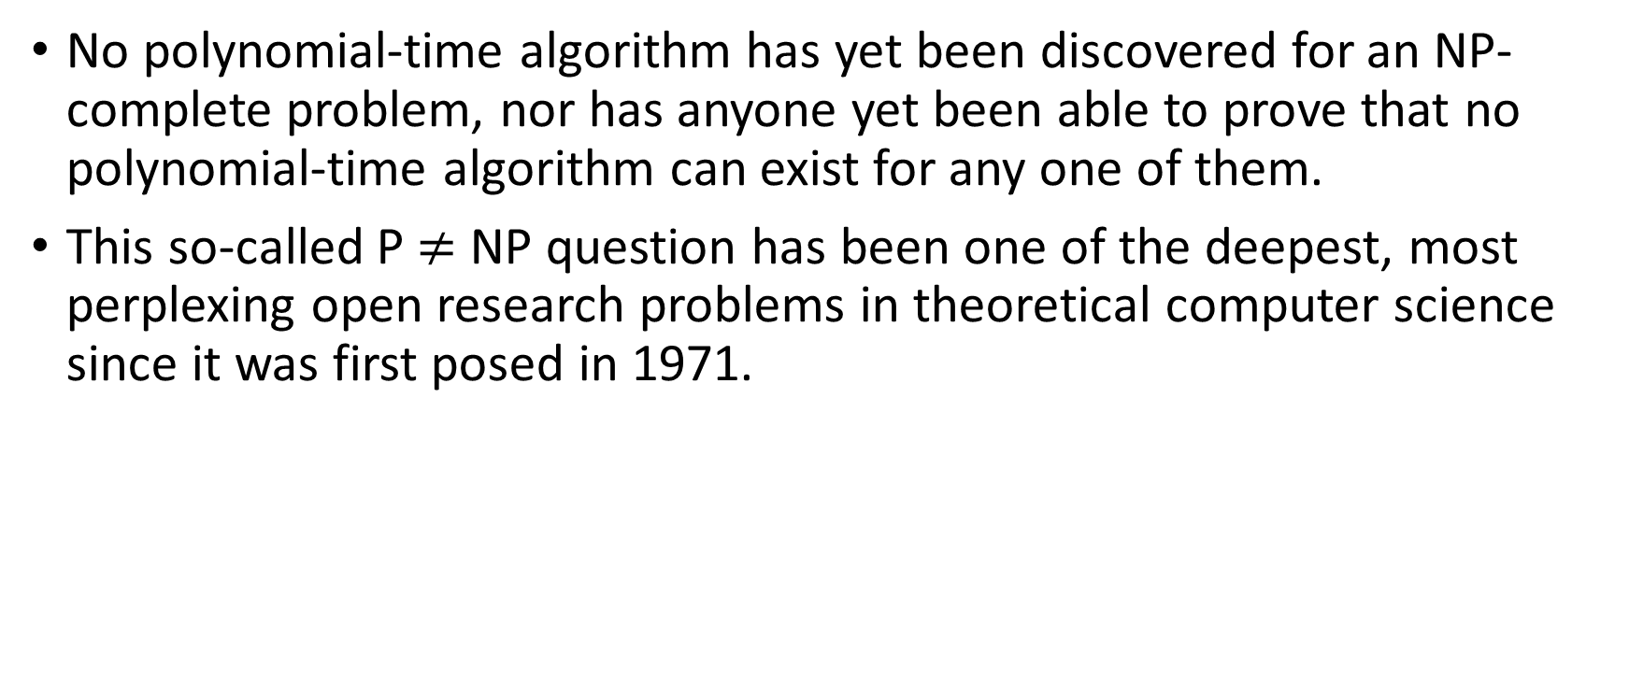
“NP-complete” problems
No polynomial-time algorithm has yet been discovered for an NP-complete problem, nor has anyone yet been able to prove that no polynomial-time algorithm can exist for any one of them.
This so-called P $≠$ NP question has been one of the deepest, most perplexing open research problems in theoretical computer science since it was first posed in 1971.

Slide 4
Comparison Between Similar Problems
In each of the following pairs of problems, one is solvable in polynomial time and the other is NP-complete, but the difference between problems appears to be slight:
Shortest vs. longest simple paths:
Even with negative edge weights, we can find shortest paths from a single source in a directed graph G = (V, E) in O(VE) time.
Finding a longest simple path between two vertices is difficult, however.
Merely determining whether a graph contains a simple path with at least a given number of edges is NP-complete.

Slide 5
Comparison Between Similar Problems (contd.)
Euler tour vs. hamiltonian cycle:
An Euler tour of a connected, directed graph G = (V, E) is a cycle that traverses each edge of G exactly once, although it is allowed to visit each vertex more than once.
We can determine whether a graph has an Euler tour in only O(E) time and, in fact, we can find the edges of the Euler tour in O(E) time.
A hamiltonian cycle of a directed graph G = (V, E) is a simple cycle that contains each vertex in V .
Determining whether a directed graph has a hamiltonian cycle is NP-complete.
Determining whether an undirected graph has a hamiltonian cycle is also NP-complete.

Slide 6
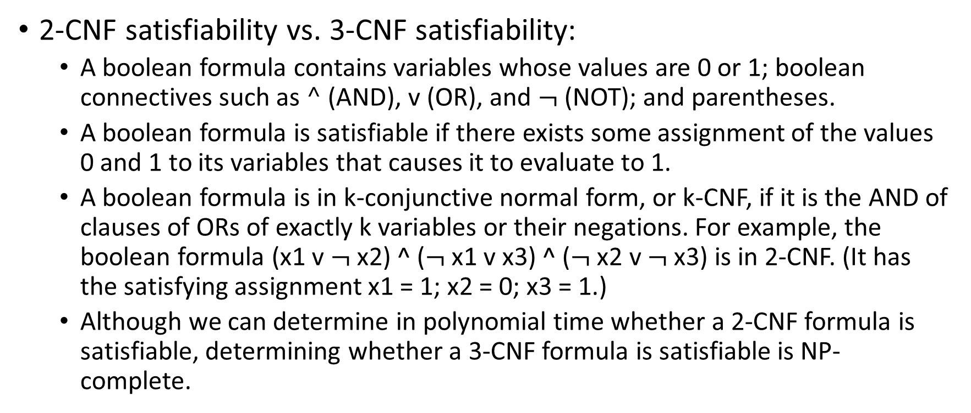
Comparison Between Similar Problems (contd.)
2-CNF satisfiability vs. 3-CNF satisfiability:
A boolean formula contains variables whose values are 0 or 1; boolean connectives such as $^$ (AND), v (OR), and $¬$ (NOT); and parentheses.
A boolean formula is satisfiable if there exists some assignment of the values 0 and 1 to its variables that causes it to evaluate to 1.
A boolean formula is in k-conjunctive normal form, or k-CNF, if it is the AND of clauses of ORs of exactly k variables or their negations. For example, the boolean formula (x1 v $¬$x2) ^ ($¬$x1 v x3) ^ ($¬$x2 v $¬$x3) is in 2-CNF. (It has the satisfying assignment x1 = 1; x2 = 0; x3 = 1.)
Although we can determine in polynomial time whether a 2-CNF formula is satisfiable, determining whether a 3-CNF formula is satisfiable is NP-complete.

Slide 7
Computational Complexity
It is really hard to prove that there is no efficient algorithm for a particular problem.
What to do?
Show that the problem is as hard as many other problems that have been worked on by a host of brilliant scientists over a very long time, yet there is no efficient solutions.
A fundamental aspect of complexity theory is categorizing problems into various equivalence classes.
Comparing relative difficulty of different problems

Slide 8


Computational Complexity (contd.)
I cannot solve it efficiently because I am dumb!
I cannot find an efficient solution because there isn’t any!
Image credit: “Computers and Intractability” by Garey and Johnson

Slide 9
Class P
The class P consists of those problems that are solvable in polynomial time.
More specifically, they are problems that can be solved in time O(n^{k}) for some constant k, where n is the size of the input to the problem.

Slide 10
Class NP
The class NP consists of those problems that are “verifiable” in polynomial time.
If we were somehow given a “certificate” of a solution, then we could verify that the certificate is correct in time polynomial in the size of the input to the problem.
For example, in the Hamiltonian cycle problem, given a directed graph G = (V, E), a certificate would be a sequence of |V| vertices.
We could easily check in polynomial time whether each edge of the sequence is in E and whether we can return to the source vertex again.
As another example, for 3-CNF satisfiability, a certificate would be an assignment of values to variables.
We could check in polynomial time that this assignment satisfies the boolean formula.

Slide 11
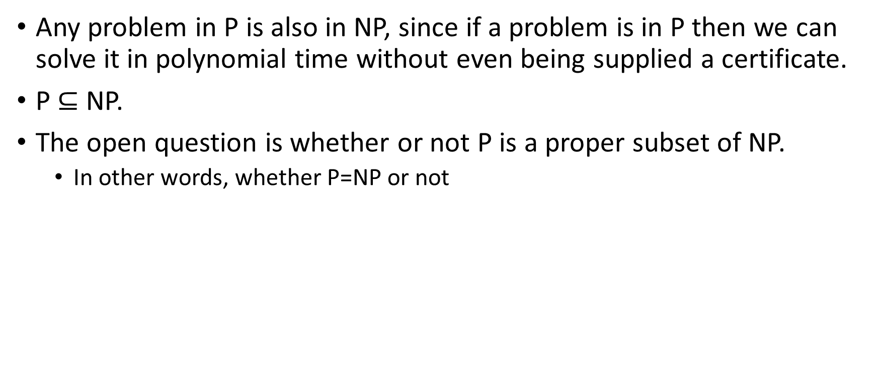
P vs NP
Any problem in P is also in NP, since if a problem is in P then we can solve it in polynomial time without even being supplied a certificate.
P $⊆$NP.
The open question is whether or not P is a proper subset of NP.
In other words, whether P=NP or not

Slide 12
What we think the world looks like
NP
P

Slide 13
Complement of a problem
For every problem X, there is a natural complementary problem X’
If the answer to X is “YES”, the answer to X’is “NO”
SAT: Is a given boolean formula in CNF satisfiable?
UNSAT: Is a given boolean formula in CNF unsatisfiable?

Slide 14
Complement of a problem
x є P => x’ є P
We have an efficient algorithm A to solve X.
We can design an algorithm A’ for X’ which runs A
and flip the answer

Slide 15
Complement of a problem
Is it true that x є NP => x’ є NP?
Just because you have an efficient certifier for X does not mean that you can design an efficient certifier for X’
YES answers verification involves “there exist” quantifier, whereas NO answer verification involves “for all”

Slide 16
co-NP
x є NP => x’ є co-NP
co-NP: Set of decision problems with a polynomial time verification for a “NO” answer
Just the opposite to NP
UNSAT: Is a given Boolean formula unsatisfiable?
UNSAT є co-NP
Notes:
If the answer of an UNSAT instance is “NO”, it means it is satisfiable. That means you will have a certificate that will satisfy the given formula. So you can verify this certificate in polynomial time.

Slide 17
co-NP
PRIME: Is a given number x prime?
NO answer verification is easy; PRIME is in co-NP
YES answer verification does not seem to be easy
PRIME is in P (Agrawal, Kayal, and Saxena (AKS))

Slide 18
NP and co-NP
Does NP = co-NP?
We don’t know yet!
What is the relationship between P and co-NP?
P is a subset of co-NP
x є P => x є co-NP
If the answer is NO for a problem and you can solve it in polynomial time, you can verify the NO answer without looking at the certificate

Slide 19
NP and co-NP
What is the relationship between P and co-NP?
P is a subset of co-NP
x є P => x’ є P => x’ є NP => x є co-NP
x є P => x є co-NP

Slide 20
What we think the world looks like
co-NP
NP
P

Slide 21
P, NP, co-NP
Just like P and NP, the widespread belief is that
NP ≠ co-NP
But we don’t know!
Proving NP ≠ co-NP is even a bigger step than proving P ≠ NP

Slide 22
P, NP, co-NP
NP ≠ co-NP => P ≠ NP
P = NP => NP = co-NP (contrapositive of the above)
If P = NP, then
NP is a subset of co-NP
x є NP => x є P => x’ є P => x’ є NP => x є co-NP
co-NP is a subset of NP
x є co-NP => x’ є NP => x’ є P => x є P => x є NP
So NP = co-NP

Slide 23
NP and co-NP Example
Travelling salesman problem: Given a list of cities and the distances between each pair of cities, what is the shortest possible route that visits each city exactly once and returns to the origin city?
Decision version of TSP: "Given a graph G, is there a path of length L or less in G that visits each vertex at least once?" is in NP.
If I say "yes, there is a path of length L or less that visits each vertex at least once"
The way I prove that is by giving you a path of length L or less that visits each vertex at least once, and the way you check my solution is by taking my path, checking that it travels to each vertex at least once, and that it's of length L or less.

Slide 24
NP and co-NP Example (contd.)
The complement of this problem would be "Given a graph G, are there no paths of length L or less in G that visit each vertex at least once?“
Verifying “yes” answer (“yes, there are no paths”) to this question is hard, because we have to exhaustively check all the paths.
Verifying “no” answer (“no, there are some paths”) to this question is easy, because we need only one path to verify it, just like NP.
To prove it, you are given a path of length L or less that visits each vertex at least once. So it is not true that “there are no paths in G of length L that visit each vertex at least once.“
So here the original problem is in NP and the complement problem is in co-NP, as it always should be.

Slide 25
NP and co-NP Example (contd.)
The SAT problem asks "does there exist a boolean assignment which makes this boolean formula evaluate to True?".
The complement problem, which is in co-NP, asks, "do all boolean assignments make this formula evaluate to False?"

Slide 26
Integer Factorization
An example of a problem that is known to belong to both NP and co-NP (but not known to be in P) is integer factorization.
Integer factorization – optimization version: Given a positive integer m, find all integer factors of m.
Integer factorization – decision version: Given positive integers m and n, determine if m has a factor less than n and greater than 1.
Membership in NP is clear.
You are given a factor, check whether it is a factor of m and whether it is less than n.
Membership in co-NP is also straightforward.
You are given some factors of m, all greater or equal to n.
You have to verify that all of them are indeed prime (by using AKS primality test) and their multiplication results in m.

Slide 27
Integer Factorization (contd.)
It is presently not known whether there is a polynomial-time algorithm for integer factorization (equivalently that integer factorization is in P), and hence this example is interesting as one of the most natural problems known to be in NP and co-NP but not known to be in P.

Slide 28
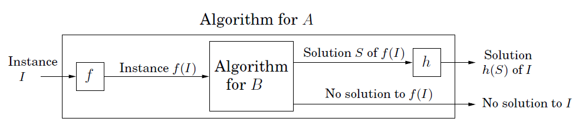
Polynomial-time Reductions
Reduction
A ≤p B
Problem A is polynomial time reducible to problem B
If A ≤p B and if we have a blackbox that solves B, then we can solve A by reducing and instance of A into an instance of B
Image credit: “Algorithms”, Das, Gupta, and Vazirani

Slide 29

Polynomial-time Reductions
Reduction
A ≤p B
Problem A is polynomial time reducible to problem B
A is at least as hard as B
B is at least as hard as A

Slide 30
Polynomial-time Reductions
Reduction
A ≤p B
Problem A is polynomial time reducible to problem B
If you can solve B in polynomial time,
then you can solve A in polynomial time
If you cannot solve A in polynomial time,
then you cannot solve B in polynomial time
Difficulty flows from A to B;
Efficiency flows from B to A

Slide 31
Class NP-hard
A problem is in the class NP-hard if it is as “hard” as any problem in NP.
The problem itself may or may not be in class NP.

Slide 32
NP-hard problems
NP-hard
Problem X is an NP-hard problem if
for all Y є NP, Y ≤p X
If a problem X is NP-hard , a polynomial-time algorithm for X would imply a polynomial-time algorithm
for every problem in NP.

Slide 33
Class NP-complete
A problem is in the class NP-complete (NPC)—if it is in NP and is as “hard” as any problem in NP.
If any NP-complete problem can be solved in polynomial time, then every problem in NP has a polynomial time algorithm.

Slide 34
NP-complete problems
NP-complete
Problem X is an NP-complete problem if:
i) X є NP
ii) for all Y є NP, Y ≤p X
NP-complete problems are the hardest problems in NP
NP-complete is a set of problems with the “same level of” difficulty
Same level of difficulty because each problem in NPC can be reduced to others. So they define both upper bound and lower bound on the difficulty. However, NP-hard problems define a lower bound. Because it is possible that one NP-hard cannot be reduced to another NP-hard.
Notes:
Same level of difficulty because each problem in NPC can be reduced to others. So they define both upper bound and lower bound on the difficulty. However, NP-hard problems define a lower bound. Because it is possible that one NP-hard cannot be reduced to another NP-hard.

Slide 35
NP-complete Problems
If you can establish a problem as NP-complete or NP-hard, you provide good evidence for its intractability.
As an engineer, you would then do better to spend your time developing an approximation algorithm or solving a tractable special case, rather than searching for a fast algorithm that solves the problem exactly.
When we demonstrate that a problem is NP-complete or NP-hard, we are making a statement about how hard it is (or at least how hard we think it is), rather than about how easy it is.

Slide 36
What we think the world looks like
NP-hard
NP-complete
co-NP
NP
P

Slide 37
Three Key Concepts
We rely on three key concepts in showing a problem to be NP-complete:
Decision problems vs. optimization problems
Reductions
A first NP-complete problem

Slide 38
Decision Problems vs. Optimization Problems
Optimization problems: each feasible (i.e., “legal”) solution has an associated value, and we wish to find a feasible solution with the best value.
Shortest path: we wish to find a path from u to v that uses the fewest edges.
NP-completeness applies directly not to optimization problems, however, but to decision problems, in which the answer is simply “yes” or “no” (or, more formally, “1” or “0”).

Slide 39
Decision Problems vs. Optimization Problems (contd.)
We usually can cast a given optimization problem as a related decision problem by imposing a bound on the value to be optimized.
For example, a decision problem related to SHORTEST-PATH is PATH: given a directed graph G, vertices u and v, and an integer k, does a path exist from u to v consisting of at most k edges?
The decision problem is in a sense “easier,” or at least “no harder” than the related optimization problem.
As a specific example, we can solve PATH by solving SHORTEST-PATH and then comparing the number of edges in the shortest path found to the value of the decision-problem parameter k.

Slide 40
Decision Problems vs. Optimization Problems (contd.)
If an optimization problem is easy, its related decision problem is easy as well.
If we can provide evidence that a decision problem is hard, we also provide evidence that its related optimization problem is hard.
Thus, even though it restricts attention to decision problems, the theory of NP-completeness often has implications for optimization problems as well.

Slide 41
Reductions
Showing that one problem is no harder or no easier than another applies even when both problems are decision problems.
Let us consider a decision problem A, which we would like to solve in polynomial time.
We call the input to a particular problem an instance of that problem.
For example, in PATH, an instance would be a particular graph G, particular vertices u and v of G, and a particular integer k.
Now suppose that we already know how to solve a different decision problem B in polynomial time.

Slide 42
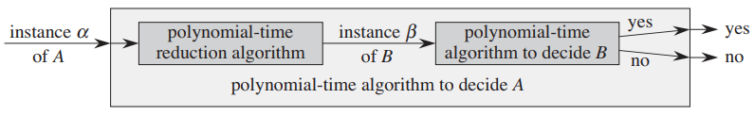
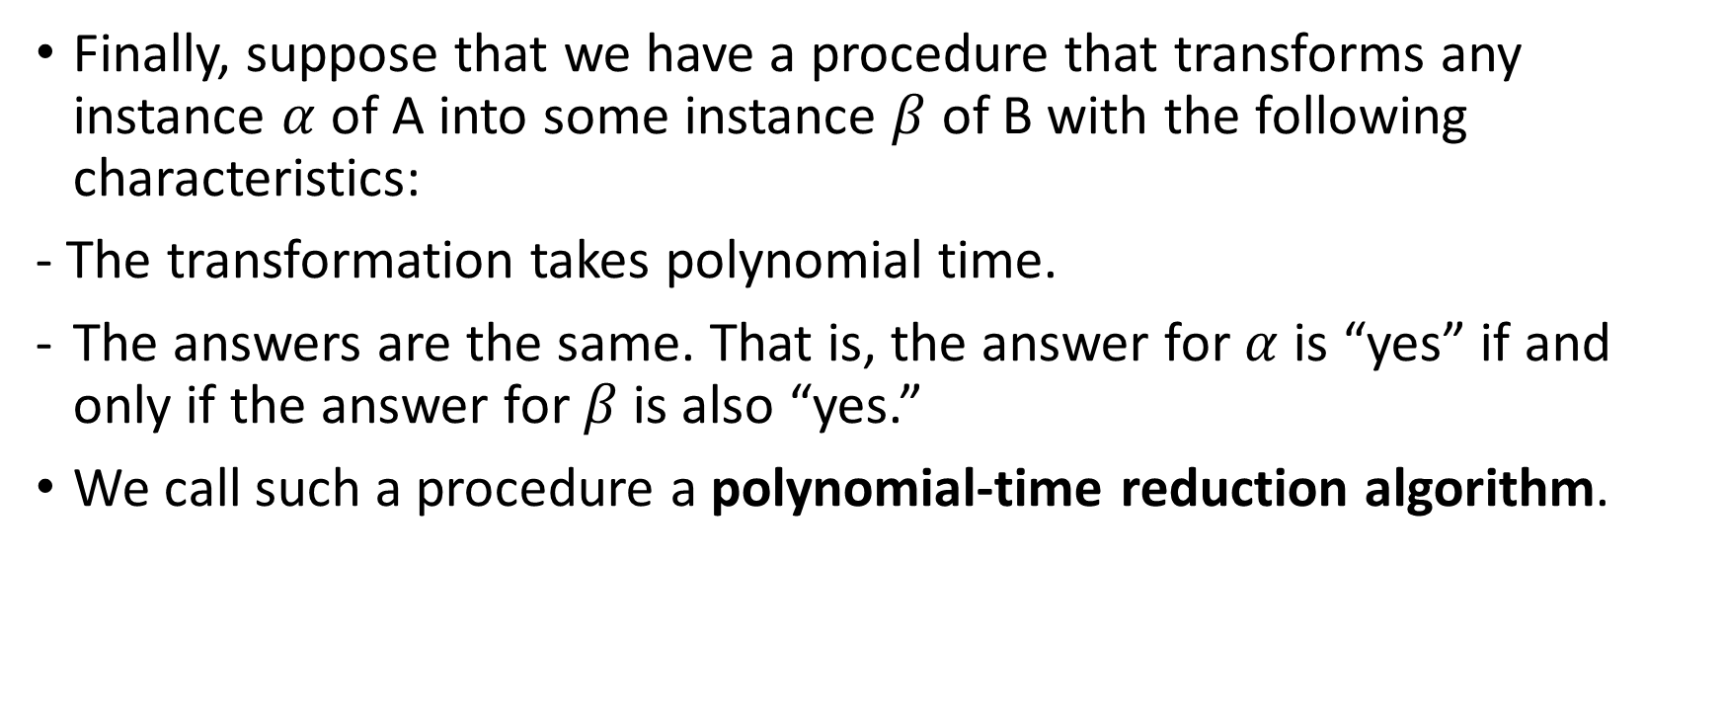
Reductions (contd.)
Finally, suppose that we have a procedure that transforms any instance $α$ of A into some instance $β$ of B with the following characteristics:
- The transformation takes polynomial time.
The answers are the same. That is, the answer for $α$ is “yes” if and only if the answer for $β$ is also “yes.”
We call such a procedure a polynomial-time reduction algorithm.

Slide 43
Reductions (contd.)
By “reducing” solving problem A to solving problem B, we use the “easiness” of B to prove the “easiness” of A.
NP-completeness is about showing how hard a problem is rather than how easy it is.
How could we use polynomial-time reductions to show that no polynomial-time algorithm can exist for a particular problem B?
Suppose we have a decision problem A for which we already know that no polynomial-time algorithm can exist.
Suppose further that we have a polynomial-time reduction transforming instances of A to instances of B.
Now we can use a simple proof by contradiction to show that no polynomial time algorithm can exist for B.

Slide 44
Reductions (contd.)
For NP-completeness, we cannot assume that there is absolutely no polynomial time algorithm for problem A.
The proof methodology is similar, however, in that we prove that problem B is NP-complete on the assumption that problem A is also NP-complete.
Polynomial time reduction
Instance of Problem A
Instance of Problem B
If problem A is known to be NP-complete, problem B is also NP-complete here

Slide 45
Proof of NP-completeness
You want to prove that problem X is NP-complete.
NP-complete
You have to prove that X is in NP and
for all problems Y є NP, Y ≤p X
Alternative: Prove that X is in NP and
a known NP-complete problem Y ≤p X

Slide 46
A First NP-complete Problem
We can use the circuit-satisfiability problem.
We are given a boolean combinational circuit composed of AND, OR, and NOT gates, and we wish to know whether there exists some set of Boolean inputs to this circuit that causes its output to be 1.

Slide 47
Vertex Cover
A vertex cover of a graph is a set S of vertices/nodes such that
every edge has at least one endpoint in S.
We try to “cover” each of the edges by choosing at
least one of its vertices.
For a given graph G=(V,E), V is always a vertex cover. It is difficult to
find the smallest vertex cover.
Vertex Cover: Decision version
Given a graph G and a number k, does G contain a vertex cover
of size at most k?

Slide 48
Vertex Cover
Vertex Cover
Given a graph G and a number k, does G contain a vertex cover
of size at most k?
1
2
Is there a vertex cover of size 4?
3
4
5
6
7
8
9
10
11

Slide 49
Vertex Cover
Vertex Cover
Given a graph G and a number k, does G contain a vertex cover
of size at most k?
1
2
Is there a vertex cover of size 4?
Yes
3
4
5
6
7
8
9
10
11

Slide 50
Vertex Cover
Vertex Cover
Given a graph G and a number k, does G contain a vertex cover
of size at most k?
Is there a vertex cover of size 4?
Yes
Is there a vertex cover of size 3?
No
1
2
3
4
5
6
7
8
9
10
11

Slide 51
Independent Set
An independent set of a graph is a set I of nodes such that
they are pairwise non-adjacent.
In trivial case, I may contain only one vertex. It is difficult to find
the largest I.
Independent Set: Decision version
Given graph G and a number k, does G contain a set of at least k
independent vertices?

Slide 52
Independent Set: Optimization vs Decision
If we can solve the decision version of Independent Set for every k, we can also find a maximum independent set.
Using binary search, we have to try for only O(log|V|) different values of k.

Slide 53
Independent Set
Independent Set
Given graph G and a number k, does G contain a set of at least k
independent vertices?
Is there an independent set of size 4?
Yes
1
2
3
4
5
6
7
8
9
10
11

Slide 54
Independent Set
Independent Set
Given graph G and a number k, does G contain a set of at least k
independent vertices?
Is there an independent set of size 7?
Yes
1
2
3
4
5
6
7
8
9
10
11

Slide 55
Vertex Cover
Vertex Cover
Given a graph G and a number k, does G contain a vertex cover
of size at most k?
Is there a vertex cover of size 4?
Yes
Is there a vertex cover of size 3?
No
1
2
3
4
5
6
7
8
9
10
11

Slide 56
Independent Set to Vertex Cover
Independent Set
Given graph G and a number k, does G contain a set of at least k
independent vertices?
Vertex Cover
Given a graph G and a number k, does G contain a vertex cover
of size at most k?

Slide 57
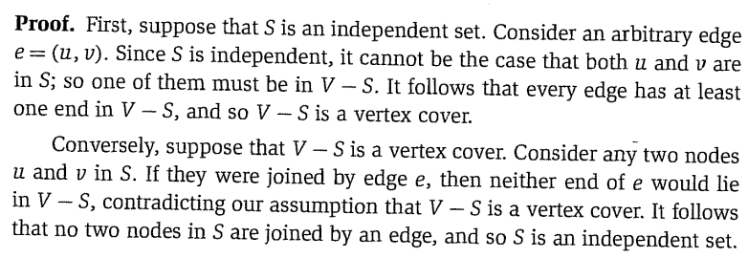
Independent Set to Vertex Cover (and vice versa)
Theorem
If G = (V,E) is a graph, then S is an independent set if and only if
V-S is a vertex cover.
Carl Kingsford, Carnegie Mellon University

Slide 58
Relationship between Independent Set and Vertex Cover
So
Independent set ≤p Vertex cover
Vertex cover ≤p Independent set
Both are in the same level of difficulty.

Slide 59
3-SAT to Independent Set
Input
An instance of 3-SAT with X = {x₁, x₂, …, x_{n}} variables
and k clauses C₁, C₂, …, C_{k}
(x ∨ y ∨ z) ∧ (x’ ∨ y’ ∨ p) ∧ (y ∨ z’ ∨ p’)

Slide 60
3-SAT to Independent Set
Non-trivial reduction as the problems are quite different in nature
A clique (triangle for a clause with three variables) for every clause
An edge between x and x’ in two different clauses
(x ∨ y ∨ z) ∧ (x’ ∨ y’ ∨ p) ∧ (y ∨ z’ ∨ p’)
x
x’
y
y
z
y’
p
z’
p’

Slide 61
3-SAT to Independent Set
x
x’
y
y
z
y’
p
z’
p’
Satisfiable ⇒ ∃ an independent set
If the instance of 3-SAT is satisfiable, then each triangle in our graph contains at least one node which evaluates to 1
Let S be a set consisting of one such node from each triangle. Then S is an independent set. Because, if S contains two adjacent vertices then both of them cannot be 1. So there is no pair of vertices having a common edge in S.

Slide 62
3-SAT to Independent Set
x
x’
y
y
z
y’
p
z’
p’
∃ an independent set of size k ⇒ Satisfiable
First, we claim that |S| = k (exactly k and it contains exactly one node from each clause). This is true because if you pick more than a two nodes from a triangle, it will not be an independent set.
Next, we prove that we can assign values (0/1) to the variables in the instance of 3-SAT problem so that it evaluates to 1

Slide 63
3-SAT to Independent Set
x
x’
y
y
z
y’
p
z’
p’
∃ an independent set of size k ⇒ Satisfiable
If x_{i} is present in the independent set (IS), x_{i} = 1
If x’_{i} is present in the independent set (IS), x_{i} = 0
If both x’_{i} and x_{i} are absent, assign any value to x_{i} (doesn’t matter)
In this example, {x, p, z’} is an IS.
x = 1, p = 1, z = 0 will satisfy the formula

Slide 64
Vertex Cover to Set Cover
Vertex Cover
Given a graph G and a number k, does G contain a vertex cover
of size at most k?
Set Cover
Given a set U of n elements, a collection of S₁, S₂, …, S_{m}
of subsets of U, is there a collection of
at most k of these subsets whose union equals U?

Slide 65
Vertex Cover to Set Cover
u₂
u₆
U = {1, 2, 3, 4, 5, 6, 7, 8}
S₁ = {1, 2, 3}
S₂ = {1, 4}
S₃ = {3, 6}
S₄ = {4, 5, 6,7}
S₅ = {2, 5}
S₆ = {7, 8}
S₇ = {8}
1
7
8
4
u₁
u₅
u₄
u₇
2
5
3
6
u₃
U = E (the set of edges)
For each vertex u_{i}, create a subset S_{i} such that S_{i} contains all the edges incident to u_{i}

Slide 66
Vertex Cover to Set Cover
u₂
u₆
U = {1, 2, 3, 4, 5, 6, 7, 8}
S₁ = {1, 2, 3}
S₂ = {1, 4}
S₃ = {3, 6}
S₄ = {4, 5, 6,7}
S₅ = {2, 5}
S₆ = {7, 8}
S₇ = {8}
1
7
8
4
u₁
u₅
u₄
u₇
2
5
3
6
u₃
∃ a set cover of size at most k ⇒ ∃ a vertex cover of size at most k
If S₁, S₂, …, S_{l} ; l <= k is a set cover of U, then every edge in G is incident to one of the vertices in corresponding to the subsets S₁, S₂, …, S_{l}. Therefore, there is a vertex cover of size l <= k.

Slide 67
Vertex Cover to Set Cover
u₂
u₆
U = {1, 2, 3, 4, 5, 6, 7, 8}
S₁ = {1, 2, 3}
S₂ = {1, 4}
S₃ = {3, 6}
S₄ = {4, 5, 6,7}
S₅ = {2, 5}
S₆ = {7, 8}
S₇ = {8}
1
7
8
4
u₁
u₅
u₄
u₇
2
5
3
6
u₃
∃ a vertex cover of size k ⇒ ∃ a set cover of size k
If {u₁, u₂, …, u_{k}} is a vertex cover in G, then by construction,
S₁ ∪ S₂ ∪ … ∪ S_{k} = U (since U is the set of all edges).

Slide 68
Reduction
Warning
You should reduce the known NP-complete problem
to the problem you are trying to prove NP-complete.
You will mistakenly do the opposite sometimes!

Slide 69
HAM cycle to TSP
HAM CYCLE -> TSP
TSP -> HAM CYCLE
We want to solve HAM CYCLE by using TSP
There is a TSP => There is a HAM CYCLE
There is a HAM CYCLE => There is a TSP
Do not forget to prove that TSP is in NP

